Slide 1
ENSE 470 Milestone 1
TEAM COVFEFE
JINPENG CHEN, TAYLEN JONES, SCOTT THOMAS
JANUARY 18, 2018

Slide 2
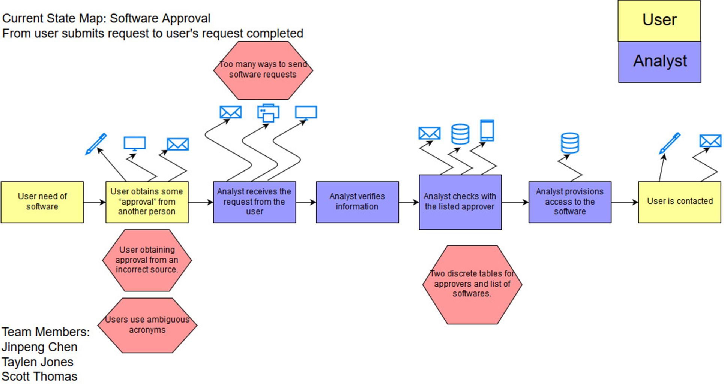
Current state Value Stream Map (VSM)
Include an image of your group’s VSM
Be prepared to discuss:
  Process flow (and types)
  Kaizen bursts (TIMWOOD themes)

Slide 3
Group reflection
How did you feel about this milestone? What did you like about it? What did you dislike?
  Helps get a base understanding for where this group project is going to go
    Pros: Working as a team, communication/planning skills
    Cons: Everybody has the same issue/prompt
What did you learn about yourself as you collaborated and worked through this milestone?
  Nothing yet, maybe in the coming milestones
How will you use what you have learned going forward?
  Creating VSM for real world project
  Effective team based project work
What “stuff & things” related to this milestone would you want help with?
  Picking a team name

